Slide 1
Office 365 Development
Patric Boscolo

Slide 2
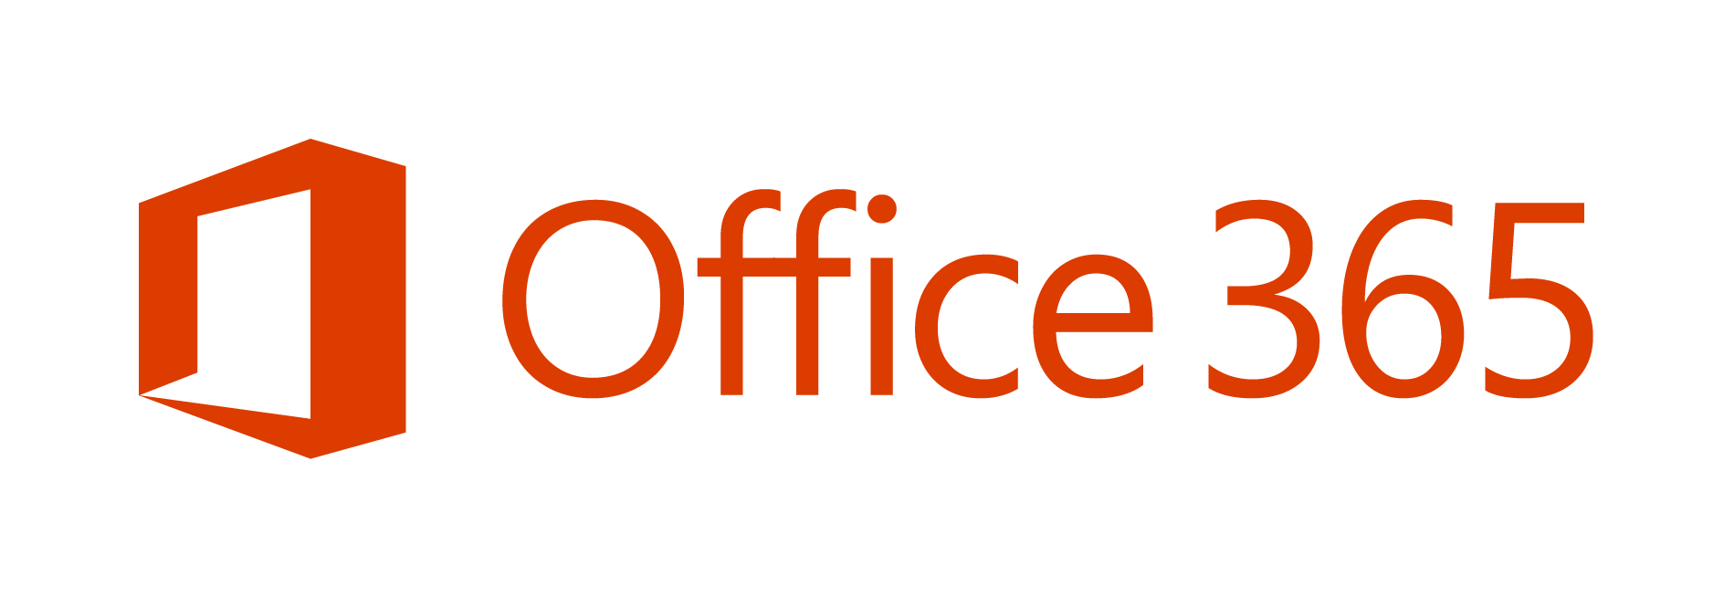
is one of the fastest growing businesses
in Microsoft history.
Notes:
1 billion people use Office – 1 in 7 people on the planet.
Office 365 is Microsoft’s fastest growing commercial product ever
Office 365 Home and Personal total more than 5.6 million subscribers, adding over 1 million subscribers again this quarter (Q4 FY14).
Commercial cloud revenue grew 147%
Annualized run rate that exceeds $4.4 billion (in Q4 FY14).
20 consecutive quarters of triple-digit customer growth Y/Y, since launch in FY09 (Q4 FY14)
35 million downloads of Office for iPad (Q4 FY14).
Over 50% of Office 365 revenue comes from international markets
Office 365 commercial seat growth in emerging markets of 162% Y/Y (Q4, FY14)
Office 365 commercial seats nearly doubled, 99% Y/Y (Q4, FY14)
Nearly 50% of Exchange licenses purchased in Q4 were cloud licenses, and 30% of the Exchange annuity installed base is now in the cloud. (For Q4, FY14)
24% of the Exchange installed base is now on Office 365, up 11pts Y/Y (Q4, FY14)
Yammer is used by more than 500,000 organizations (Q4, FY14 - WPC)
Over 40% of Office EA renewal licenses were in the cloud, up from 10% last year
Over 80% of enterprise customers have more than 1 workload
70% of Fortune 500 companies have purchased Office 365 in the last 12 months
7 out of 10 Fortune 500 Manufacturing companies have a Microsoft cloud enterprise service.
6 out of 10 Fortune 500 Financial Services companies have a Microsoft cloud enterprise service.
SMB partners transacting over the trailing 12 months grew over 2x Y/Y (Q4, FY14)

Slide 3

"The most strategic developer surface area for us is Office 365“ - Satya Nadella
Notes:
Why?
The key to enterprise productivity going forward
Microsoft’s strategic advantage in the Enterprise
Partners and Developers are key to its success

Slide 4


Where are we?
FY13
FY14
FY15
Feb 2013
Momentum
Today
Launched Office 365
Over
apps paid
Extend Office across endpoints
1200
apps
Target
More than
all
3,400,000
with over
millions
worldwide devs & partners
142+
Office + SharePoint developers
installs
Expand REST APIs
New markets opening March 2013
400+
Open platform existing solutions
Petabytes of data in Office 365 (March 2014)

Slide 5
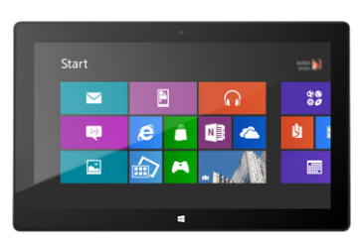



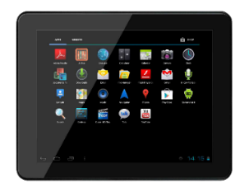
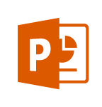
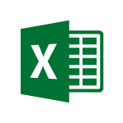
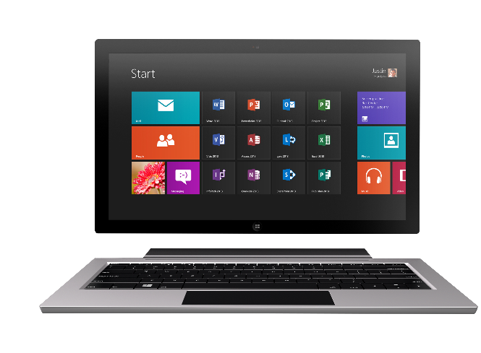
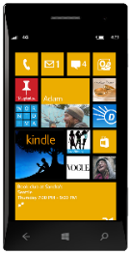

Technology journey
PC
1990s
PC + Servers
2000s
Devices + Cloud
2010s
VBA
VBA
Com add-ins
VSTO
FTC
Open standards
Mobile SDK’s
Notes:
Technology Journey
Respect for the investments that you’ve already made
Reaching out to a whole new world of possible.

Slide 6
The Opportunity
Mobile Devices
1.2B in 2014
1.8B in 2018
1B+
400+ PB
2-3 hours/day in Office Apps
Notes:
Why should you care?
Office 365 is the fastest growing commercial product in MS history
SharePoint used to hold this crown
SP commanded a $7B partner revenue attach
Office development is another Socket to attach to jump on that train!
Why?
Business Users, Consumers all use Office
Office is the universal language of productivity
1B+ Users
1.2 – 1.8B mobile devices in the next 4 years
2-3 hours in Office a day
400+ Petabytes of data
Valuable business data!
Office lets you move across the stack
SMB <-> EPG

Slide 7
Office 365 is a rich platform ripe for extending and integrating with.

Slide 8
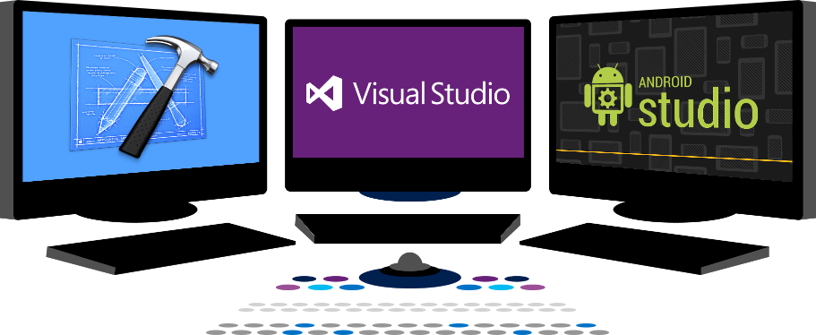

Vision
EXTEND OFFICE EVERYWHERE
CONNECT TO OFFICE 365 SERVICES
BUILD USING AN OPEN PLATFORM
dev.office.com

Slide 9













Vision
EXTEND OFFICE EVERYWHERE
CONNECT TO OFFICE 365 SERVICES
BUILD USING AN OPEN PLATFORM
Delve
z
Users and groups
Files
Mail
Calendar
My Apps
Video Portal
Contacts
Office Graph
Presentations
Documents
Spreadsheets
Lync
OneNote
Yammer

Slide 10
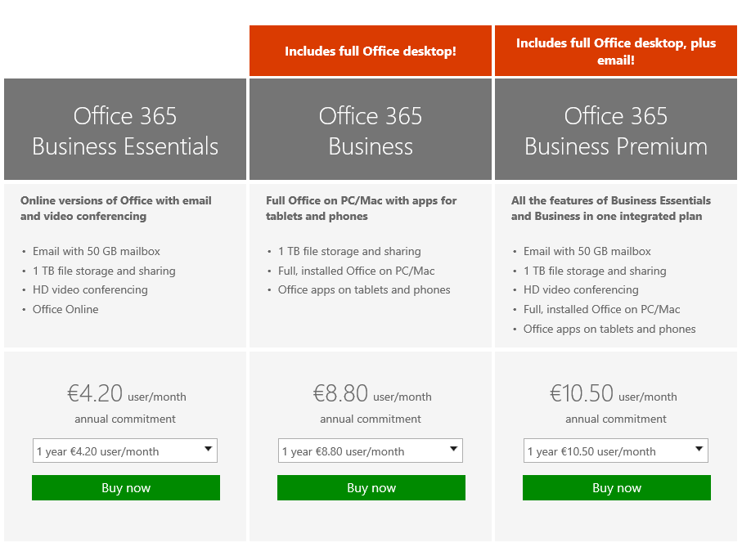
SKU Public
https://products.office.com/en-ie/business/compare-office-365-for-business-plans

Slide 11
Office 365 App Model
Office 365 Development Overview

Slide 12
App Model Redux
PRINCIPLES
Designed for openness and flexibility
Enabling a consistent development platform
Powering a world of devices
TIGHTLY BOUND
LOOSELY COUPLED
Host process
Solution host
Productivity service
O365 APIs and Office.js
Solution
Solution
Platform
Platform
Notes:
App Model Redux
Why we do what we do
It’s not just about the cloud
Framework how we think about going forward.

Slide 13
What’s New
EXTEND OFFICE EVERYWHERE
CONNECT TO OFFICE 365 SERVICES
BUILD USING AN OPEN PLATFORM
My Apps
Users and groups

Slide 14
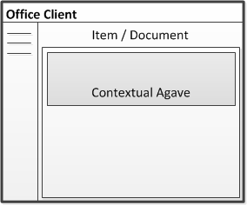
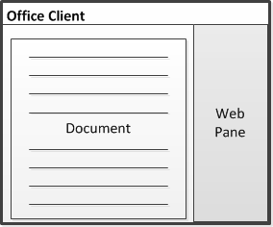
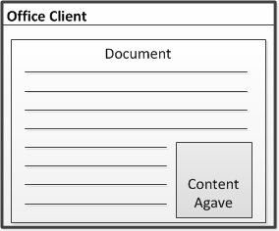
Apps for Office A new way to build extensions for Office
Outlook, Outlook Web Access
In context of mail, calendar items, people card
Contextual pane
Word, Excel, PowerPoint, Project
Task pane area with read/write access to document contents
Task pane
Excel, PowerPoint
App runs within a documents content
Embedded content

Slide 15
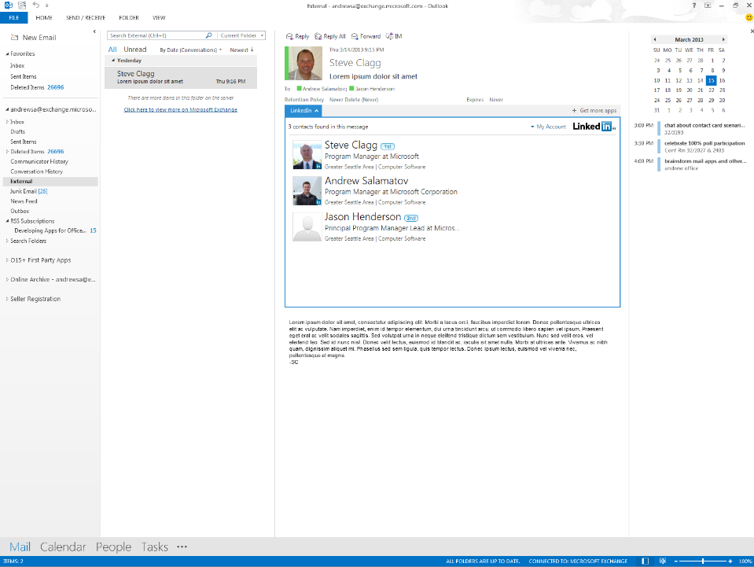
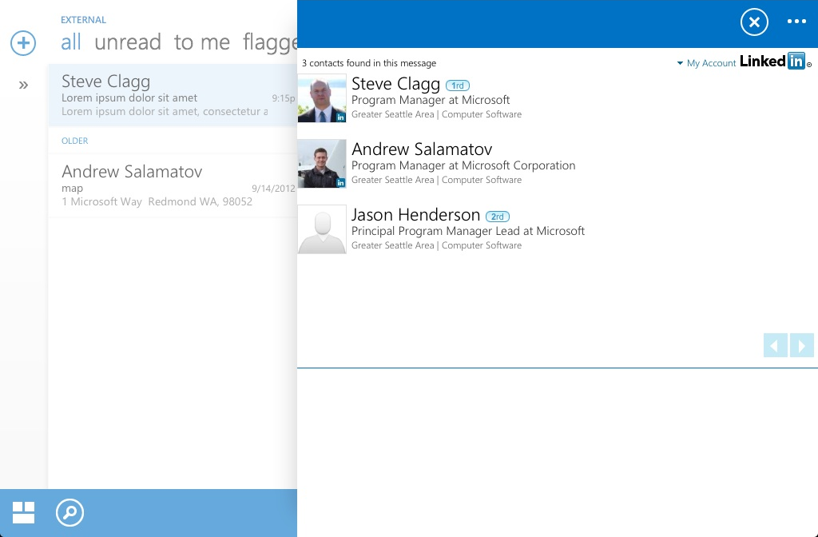
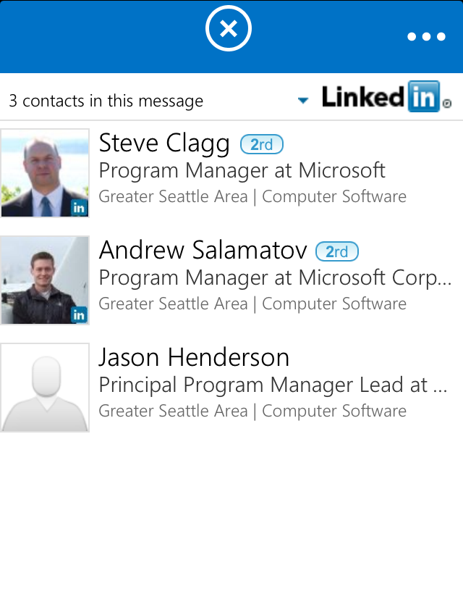
Mobile friendly Write once, run everywhere
Desktop and Web
Tablet
Phone

Slide 16
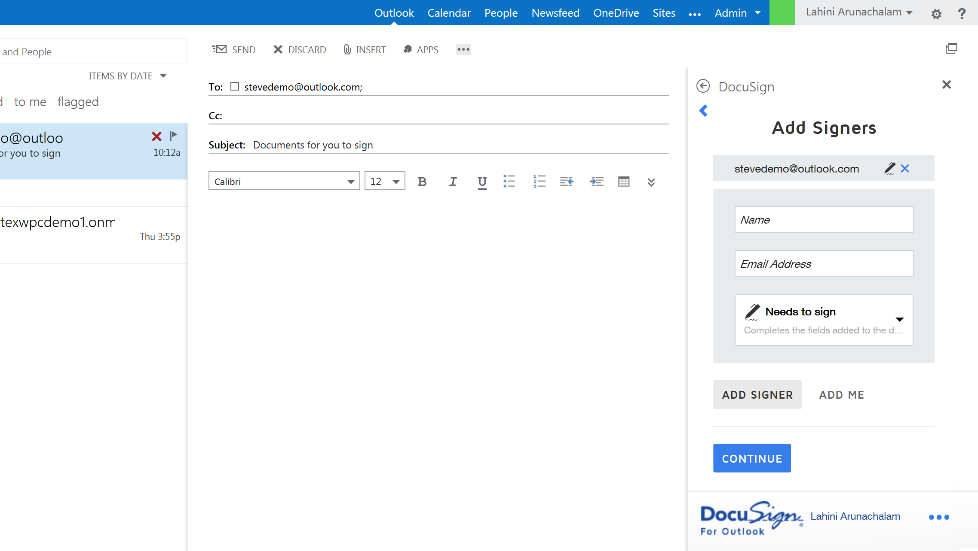

Slide 17
Demo

Slide 18

App Model Development
If you know general web development, you also know Office 365 development…
Notes:
Same code works in cloud and in on-premises
Build market place apps and reach all Office 365 customers easily
More flexible model with additional possibilities
Standard .NET development tooling

Slide 19
Benefits of the new app model
Safe and robust
App code runs outside of Office … with clear security boundaries
Clearly defined API build on modern standards
Device friendly
Apps run in the full Office client apps
Works on Tablets and Phones
Modern development
Build Apps for Office using modern development tools and technologies
Robust APIs in Office and Office 365
Flexible tools such as HTML5, Azure and Visual Studio
Notes:
Take away
Make smaller changes - ripples - rather than big, disruptive wave changes.
Key talking point - “No more hotfixes, service packs, or major upgrades. Office 365 ProPlus can be the last Office client you’ll ever deploy.”
Some customers have expressed concern regarding the inclusion of security update and non-security updates in the monthly Office 365 ProPlus updates, and the frequency with which those updates might be released.
O365 ProPlus Servicing
In a services world, we are constantly providing small, incremental enhancements to the security and value of our Office 365 services, including Office 365 ProPlus.
Each month, a new build of Office 365 ProPlus may be released in the cloud. Each monthly build may contain security updates, non-security updates, and functionality improvements.
Updates are cumulative, so each build contains all the other changes from previous builds, however only the difference- or delta- between the new build and the existing one is installed.
Deltas are downloaded in the background and applied when Office apps are not running (or upon reboot).
Some examples of the non-security value in monthly updates:
Changing the Lync Icon on the Task bar to show presence (October, 2013)
Adding spell check into the Lync client (October 2013)
Changing “Enable updates” to “Apply Updates” (Feb 2014)
PowerMap Add-in for Excel (Feb 2014)
Traditional Model (MSI)
Any software update involves changing code, regardless of the type of update, and so there is the same inherent risk when applying updates.
The traditional method of on-prem deployment (where there are 1 or more security updates and 1 or more non-security updates per month) provides the ability for IT groups to deploy certain types of change in their environment without testing (ie, security updates), and reject or delay other changes that may require more testing. But this provides the illusion of control since they can’t see what code has been changed. So this approach really means “I’m OK with deploying code changes in my environment, but I’m NOT OK with deploying code changes in my environment.”
Change Management and Risk Control
When managed properly, the new update model actually reduces your risk…and it significantly reduces your testing efforts. Meaning, if you are an organization that performs testing of Office updates prior to distributing them to your end-users, then you’re going to perform the same testing regardless of what’s inside the update, security or non-security.
This provides IT groups the ability to leverage a single process to manage change in their environment, regardless of what the change is. Having fewer processes to manage makes introducing change more consistent, increases your ability to automate such processes, and greatly reduces your risk that comes with managing variance in your IT environment. One approach is to deploy a new build to a pilot audience.
Use Telemetry to provide objective data regarding usage or issues that arise for users with the new build. This will help provide an evidence-based approach to determining “does this build work for me?”

Slide 20
App for SharePoint
Full Page
Implement complete app experiences to satisfy business scenarios
Parts
Create app parts that can interact with the SharePoint experience
UI Command Extensions
Add new commands to the ribbon and item menus

Slide 21
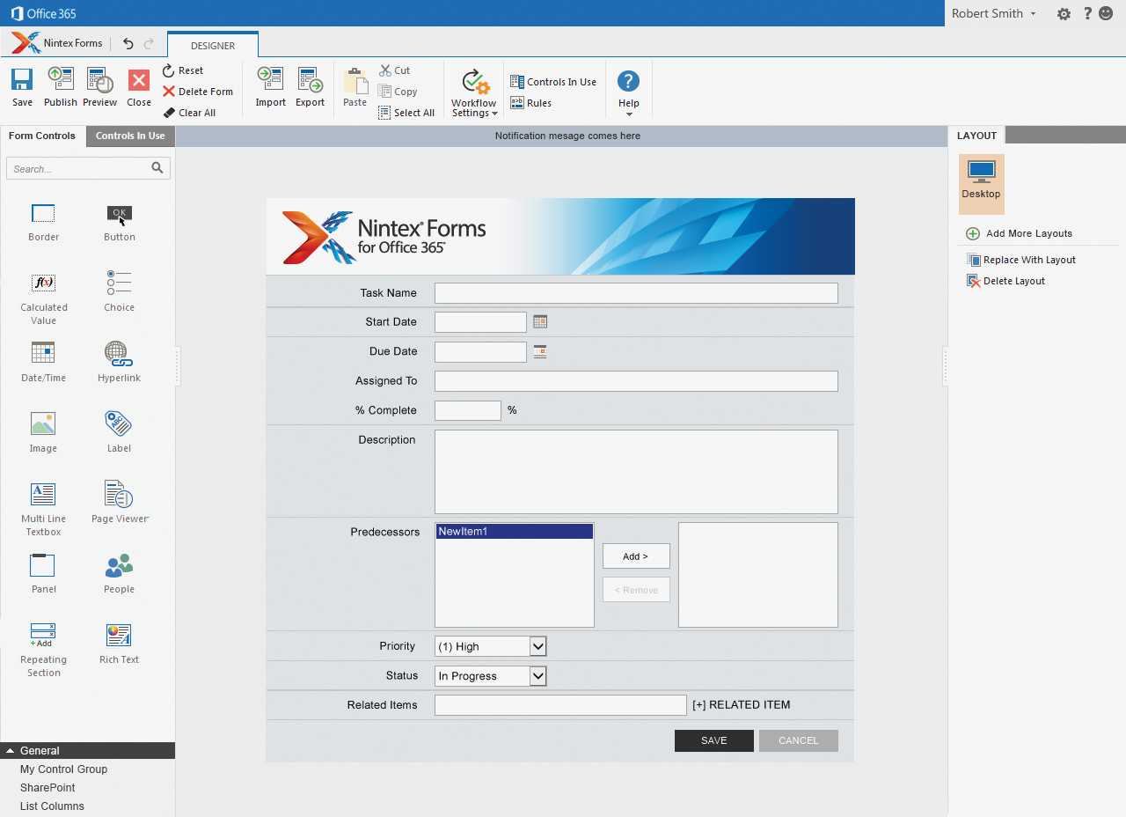
Full Page Connected App Provider Hosted in Azure

Slide 22


Distribution choices
Office Store
App Catalog
Notes:
Lifecycle
Not just the store
Momuntem has been building store and on-prem
Store features ; subscriptions
Business-ready
Corporate catalog
Training users to get new experiences

Slide 23
Corporate App Catalog
Secure access to internal apps
Centrally managed repository of private apps
Direct deployment to employees

Slide 24

Connect to Office 365 services

Slide 25
Robust Office 365 APIs
Designed for openness and flexibility
Enabling a consistent development platform
Powering a world of devices
https://api.office.com/discovery/me
Notes:
Connected apps use the Office 365 APIs
They are based on open standards such as REST and Oauth
They are much like any other API on the internet
They are accessible on any platform and power app experiences on all devices
Developers can connect over 400 PB of Documents, Mail, Calendar and other data in Office 365 through these.
MS ship tooling with Visual Studio for Windows and Windows Phone development
MS ship an Office 365 SDK for Android
We will ship an iOS SDK later this year

Slide 26

Office 365 APIs
Simple REST/OData APIs
Versioned
Expose Files, Sites, Mail, Calendar and Users
AuthN/AuthZ via Azure AD and OAuth
Users and groups
Files
Mail
Calendar
Contacts

Slide 27
Robust Office 365 APIs
Designed for openness and flexibility
Enabling a consistent development platform
Powering a world of devices
https://api.office.com/discovery/me
Documents
Mail
Calendar
People
Search
Social
iOS
dev.office.com

Slide 28
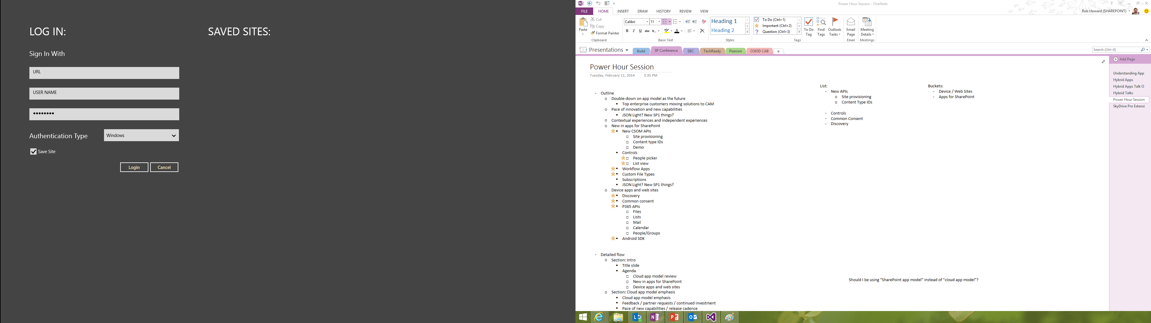
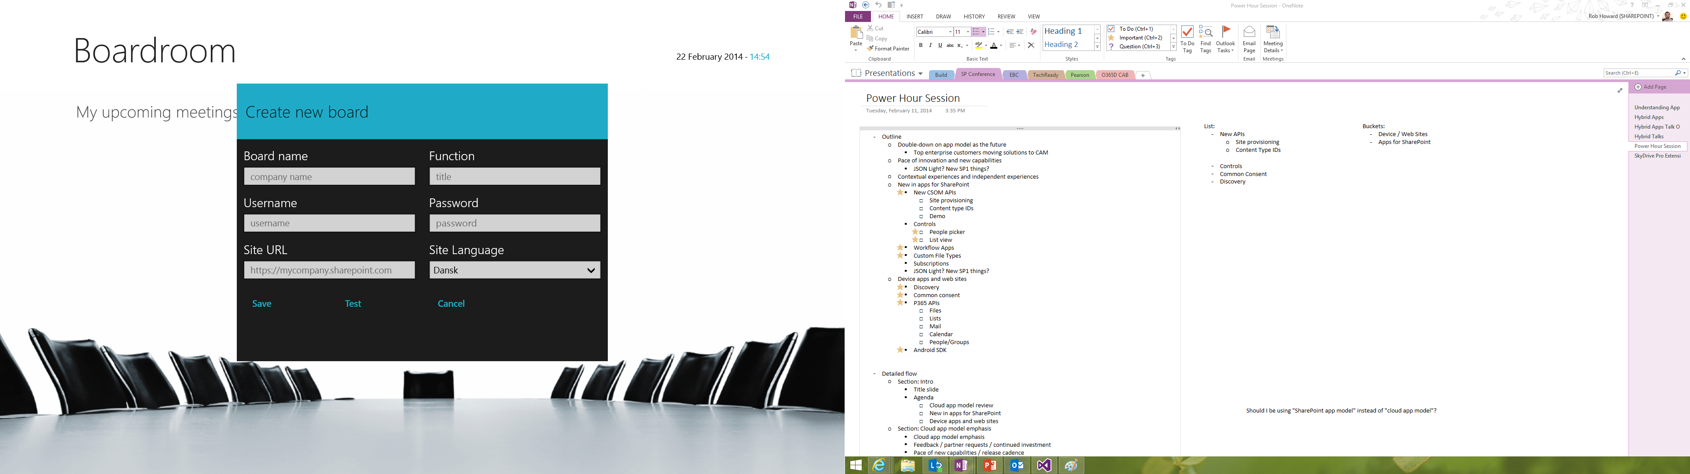
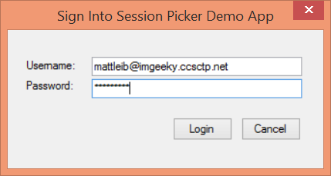
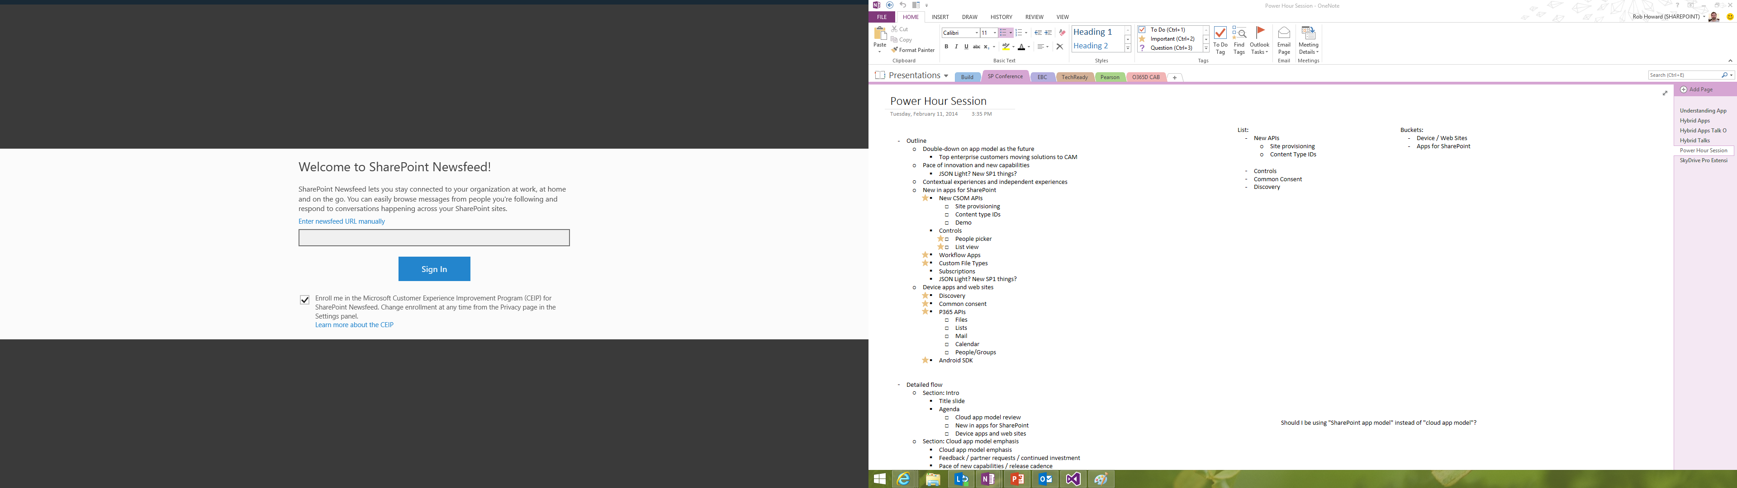
Office 365 device apps

Slide 29
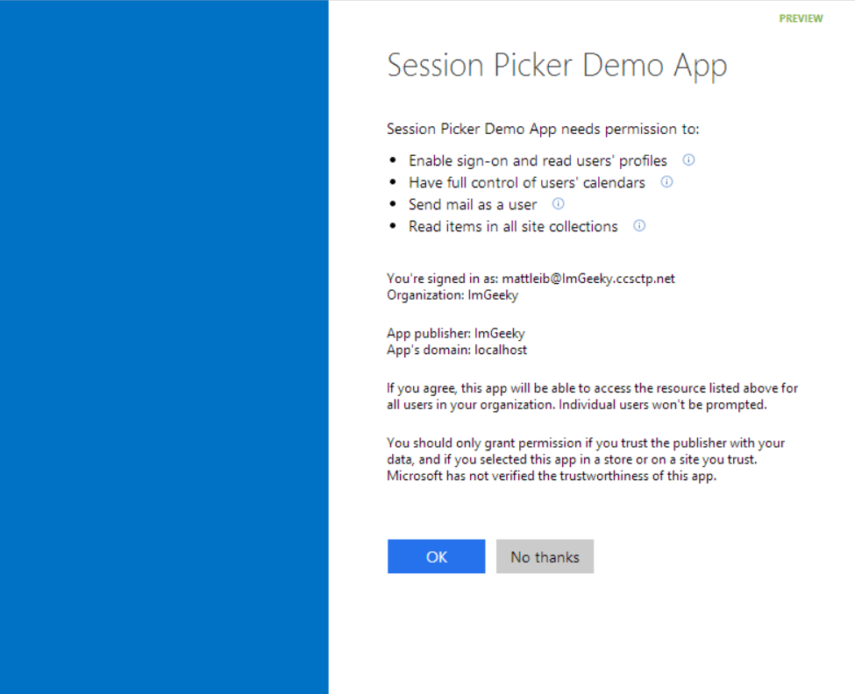
Common Consent

Slide 30
The SharePoint client APIs
Sites, Lists and Libs
Workflow
Search
Taxonomy
BCS
…
_api
Execute query
REST/ OData
JavaScript library
Silverlight library
.Net CLR library
Custom client code

Slide 31
Office 365 APIs
Active Directory
Exchange & Outlook.com
SharePoint
OneDrive
Sites
OneDrive
Users
Mail
Calendar
Client API
OneDrive for Business
Sites, Lists and Libs
Taxonomy
Groups
Contacts
Workflow
BCS
Search
…

Slide 32
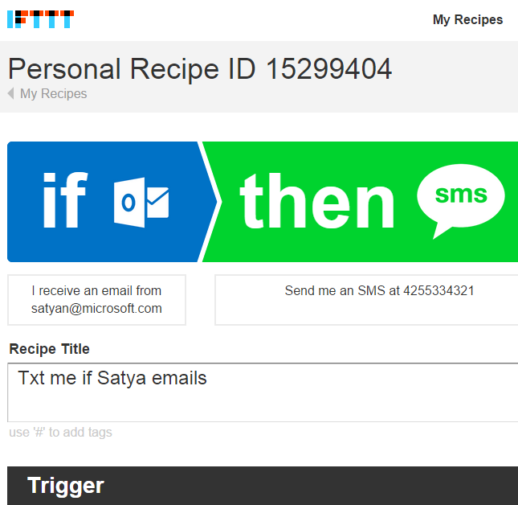
IFTTT
18mil recipes run a day
140 channels
17mil personal recipes
50mil channel activations

Slide 33
DEMO
Notes:
IFTTT, API Sandbox

Slide 34
.NET SDK
ASP.NET MVC
ASP.NET WebForms
WPF

Slide 35

Cross platform
ASP.NET MVC
ASP.NET WebForms
WPF

Slide 36
Native
ASP.NET MVC
ASP.NET WebForms
WPF

Slide 37
demo
Windows 10
Notes:
EmpOnBoard by Chaks

Slide 38
Connect
Übersicht über O365 API https://msdn.microsoft.com/en-us/office/office365/api/API-catalog Kalender https://msdn.microsoft.com/office/office365/APi/calendar-rest-operations#CreateEvents Kontakte https://msdn.microsoft.com/office/office365/APi/contacts-rest-operations#GetContacts
Synchronisation mit O365 https://dev.office.com/code-samples-detail/2429 Und hier findet man das passsende Github Sample https://github.com/OfficeDev/O365-Win-Snippets
Übersicht über Unterstützte Dienste
https://support.office.com/en-sg/article/Sync-basics-what-you-can-and-cannot-sync-5537d587-4930-4ac2-b044-3568509b1294

Slide 39
Continuous innovation
2013
2014
2015 onwards
Apps for SharePoint
Apps for Office
VS tooling
Store and lifecycle
Contextual apps
Compose time apps
Robust Office 365 APIs
Tools and platform
Android and iOS SDK
Adding new endpoints
More APIs (Tasks, Office Graph)
More SDKs (PHP)
Embracing Open
Integrating platform + Tools
Empowering users
Notes:
Specific talking points on “show some leg:”
Endpoints
Building Apps for Office on the MAC
Filling in Apps in Office Online, Word
Connecting Entities
Adding Entities for feeds and tasks.
Embracing more of O365
Working on tools to help developers navigate between entities, like you see in Pulse (We’re showing this, right?)
Embracing Open
Double-down on open standards, interop, protocols and programming frameworks
Making more open source projects
Contributing to more open source projects
Integrating Platform
Easier to manage apps across Azure and O365
More support from VS for apps across not just SharePoint, but all of O365
Empowering Users
Make it easier for users to build solutions without code
Connect those solutions to enhancement from pro-devs

Slide 40
Resources
Office 365 Development Overview

Slide 41
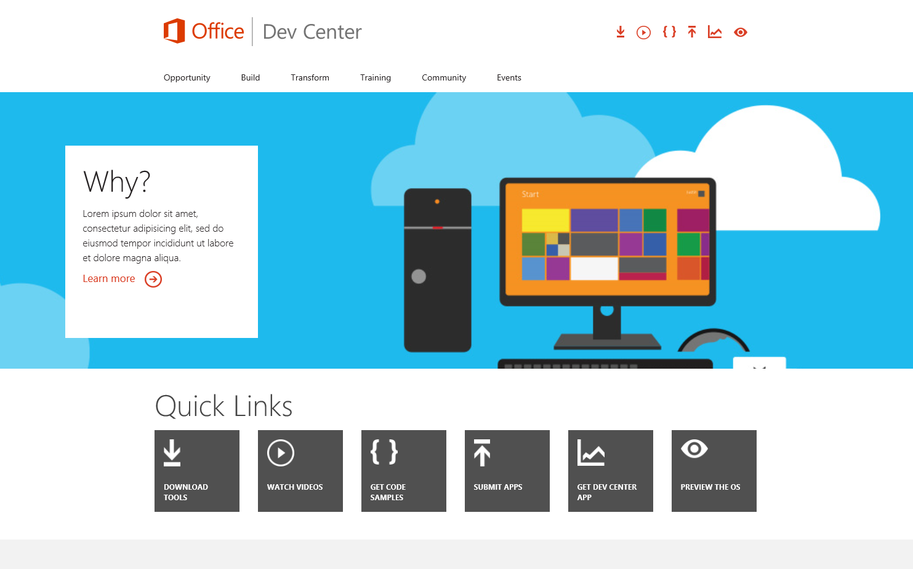
http://dev.office.com
dev.Office.com
Opportunity
Build
Transform
Code Samples
Patterns & Practices
API Reference

Slide 42
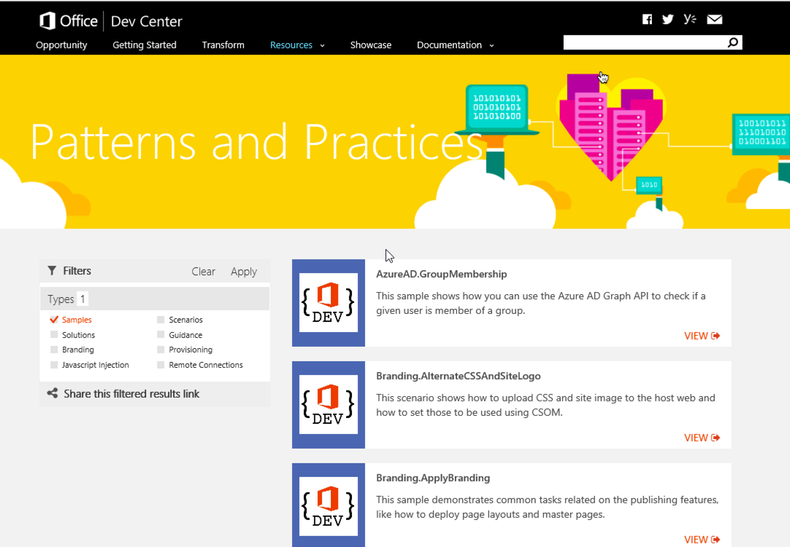
Patterns & Practices
Providing App Model Patterns for common Full Trust Code scenarios
130+ Visual Studio Projects
Common scenarios
Branding
Site Provisioning
Remote Event Receivers
Large file support
Taxonomy driven navigation
And much more…
http://dev.office.com/patterns-and-practices

Slide 43
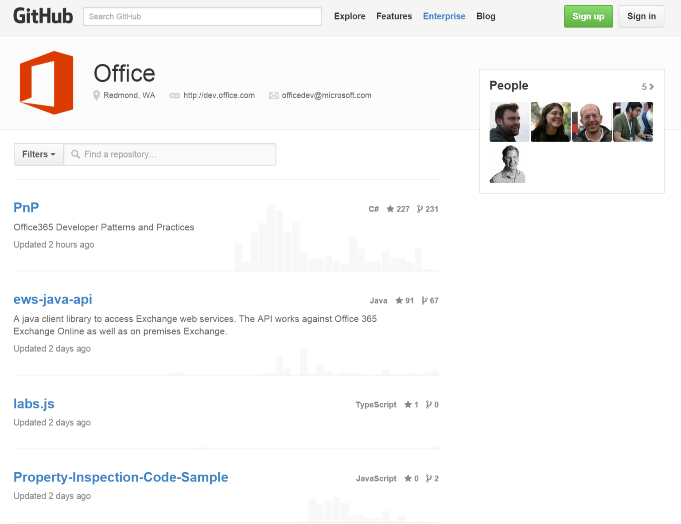
http://www.github.com/OfficeDev
Github.com/OfficeDev
SDKs
Android and iOS SDKs
Code Samples
WikiPedia App for Word
Campaign Manager for Android
Expense Manager for Windows 8
Research Manager inc. AngularJS
Building Snippets for Word
Contribute
We want your enhancements and your samples!

Slide 44
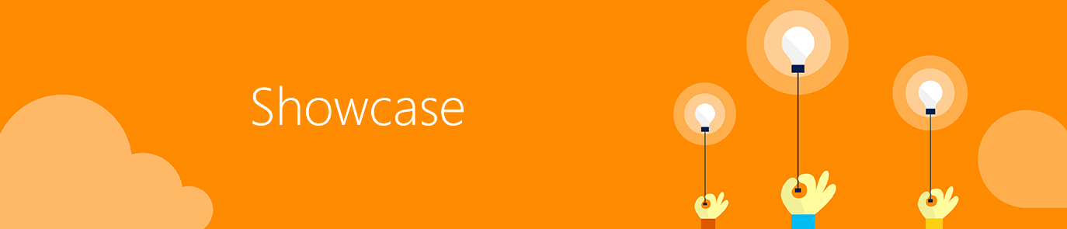
Showcase
http://dev.office.com/showcase

Slide 45
Virtual Academy Courses
Office 365 Development
Course 1: Introduction to Office 365 Development
Course 2: Deep dive into the Office 365 App Model
Course 3: Deep Dive into integrating Office 365 APIs with your standalone web application development
Course 4: Deep Dive into integrating Office 365 APIs with your mobile device development
Course 5: Shipping your Office 365 App to the Office Store
Course 6: Deep dive into the building blocks and services of the SharePoint platform
Course 7: Deep Dive into Office 365 Development on non-Microsoft Stack
http://www.microsoftvirtualacademy.com/product-training/office-development

Slide 46
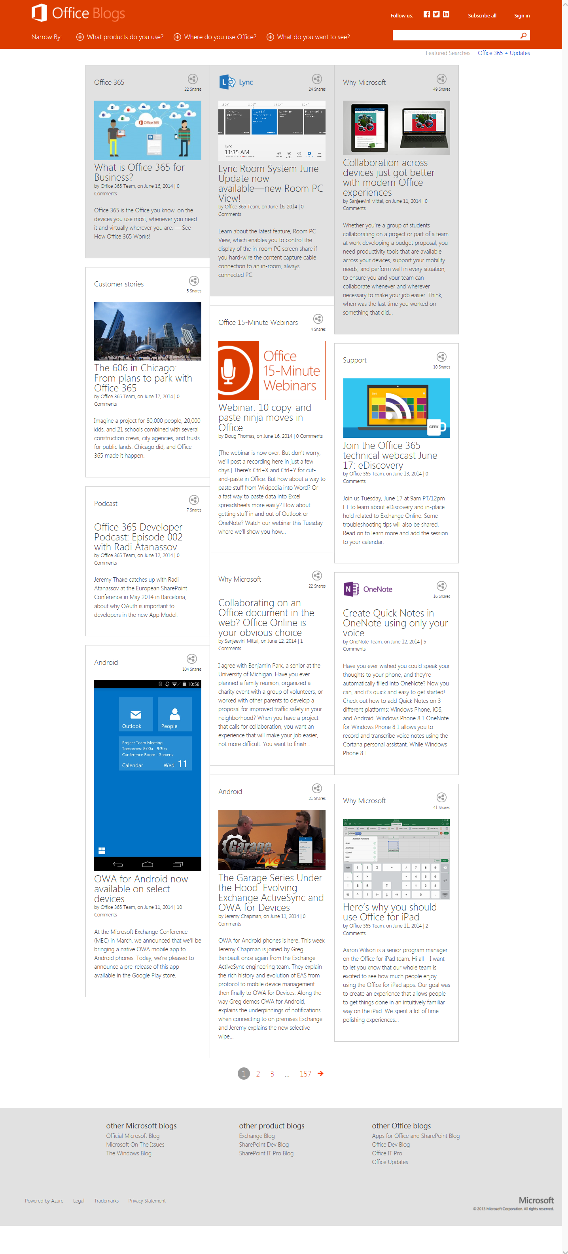
http://blogs.office.com
Office 365 news
Dev announcements
Events
Garage Series videos
Weekly podcast

Slide 47
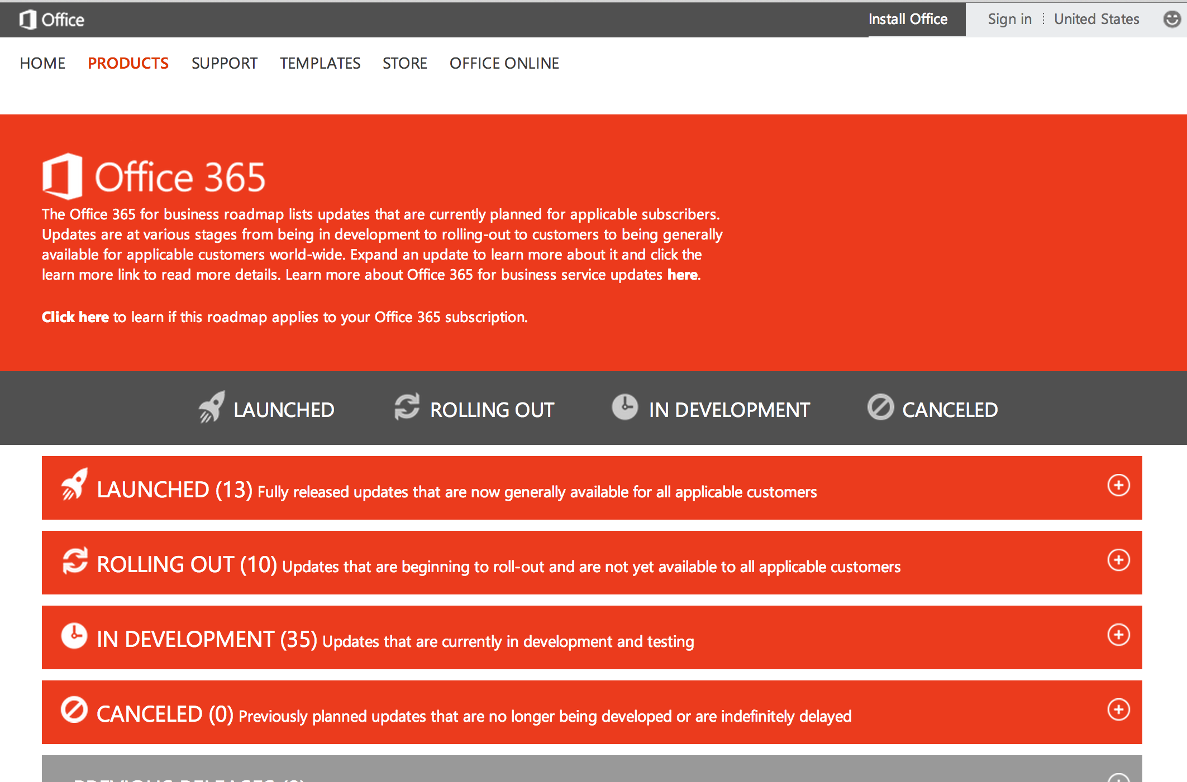
http://www.office.com/roadmap
Monthly updates
Developer features
Associated blog posts

Slide 48


Engage
UserVoice Provide suggestions of what you want in future versions
http://officespdev.uservoice.com/
Twitter Follow our tweets announcing news and relevant dev content
http://www.twitter.com/OfficeDev
Podcast Follow our tweets announcing news and relevant dev content
http://dev.office.com/podcasts
Office 365 Network Share you best practices and join conversations https://www.yammer.com/itpronetwork
Stackoverflow Ask deep technical questions to a world-wide set of developers
http://stackoverflow.com/questions/tagged/ms-office

Slide 49


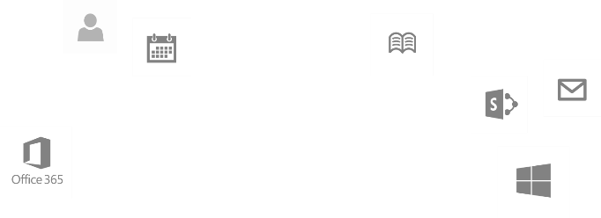
dev.office.com
Sign up
http://dev.office.com/build
Explore
http://api.microsoft.com
Get trained http://dev.office.com/training

